Slide 1

CRM Training

Slide 2

CRM
Enterprise resource planning(ERP)
What is ERP ?
Enterprise resource planning (ERP) systems help organisations manage their
businesses with efficiency and flexibility—bringing together finance,
manufacturing, retail, supply chain, warehouse, and stock.
Use of ERP
Automate routine tasks
Unify operations
Identify areas needing support
More efficient operations.
Ref: https://dynamics.microsoft.com/en-in/erp/enterprise-resource-planning-system/?ef_id=_k_Cj0KCQjwsuSzBhCLARIsAIcdLm6_KVNCw4NlVguGM67eGgskn1KtEluaOZb4I_rJhZsEFLy9VKqLiqoaAqv_EALw_wcB_k_&OCID=AIDcmm989wn4gn_SEM__k_Cj0KCQjwsuSzBhCLARIsAIcdLm6_KVNCw4NlVguGM67eGgskn1KtEluaOZb4I_rJhZsEFLy9VKqLiqoaAqv_EALw_wcB_k_&gad_source=1&gclid=Cj0KCQjwsuSzBhCLARIsAIcdLm6_KVNCw4NlVguGM67eGgskn1KtEluaOZb4I_rJhZsEFLy9VKqLiqoaAqv_EALw_wcB
EFFIGENT SOFTWARE SOLUTIONS
WWW.EFFIGENTSOLUTIONS.COM

Slide 3
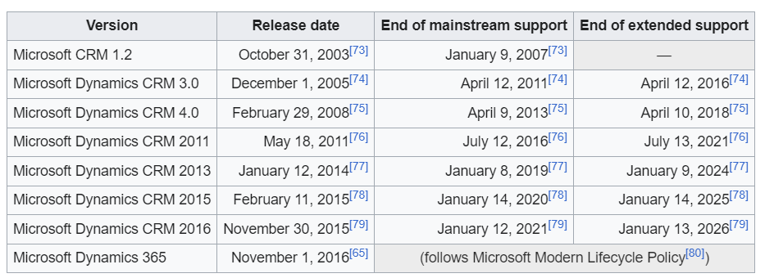
CRM
Dynamic CRM Introduction
What is CRM ?
Customer relationship management (CRM) is a set of integrated, data-driven
software solutions that help manage, track, and store information related to
your company’s current and potential customers. By keeping this information in
a centralized system, business teams have access to the insights they need,
the moment they need them.
Use of CRM
CRM systems automatically collect a wealth of information about existing
and prospective customers. This data includes email addresses,
phone numbers, company websites, social media posts, purchase histories,
and service and support tickets. The system next integrates the data and
generates consolidated profiles to be shared with appropriate teams.
CRM Versions and features
EFFIGENT SOFTWARE SOLUTIONS
WWW.EFFIGENTSOLUTIONS.COM

Slide 4
CRM
References
History of CRM: https://en.wikipedia.org/wiki/Microsoft_Dynamics_365
Release of CRM : https://support.microsoft.com/en-us/topic/microsoft-dynamics-365-releases-17837bba-5689-2216-22c0-e8c7a032c3a6
Road Map : https://releaseplans.microsoft.com/en-US/?app=Sales&rp=all-plans
EFFIGENT SOFTWARE SOLUTIONS
WWW.EFFIGENTSOLUTIONS.COM

Slide 5
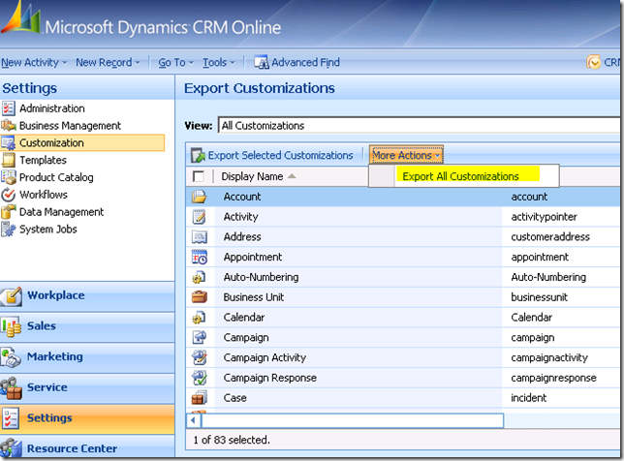
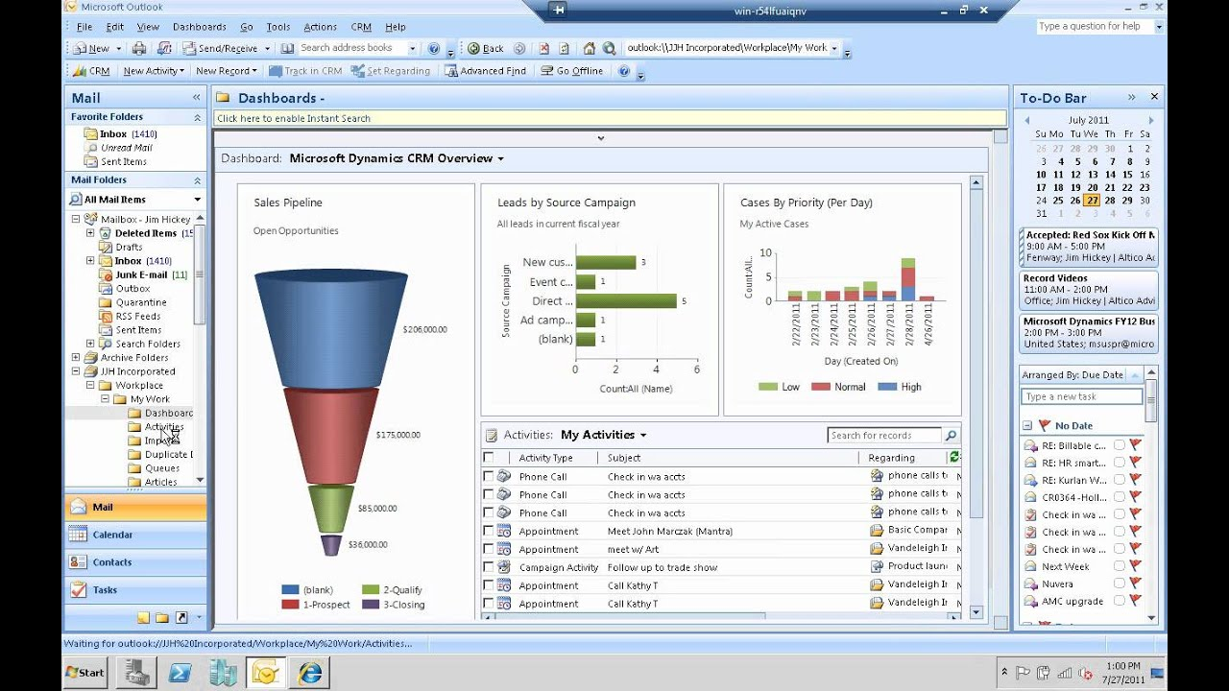
CRM
CRM Versions
CRM 4.0
CRM 2011
EFFIGENT SOFTWARE SOLUTIONS
WWW.EFFIGENTSOLUTIONS.COM

Slide 6
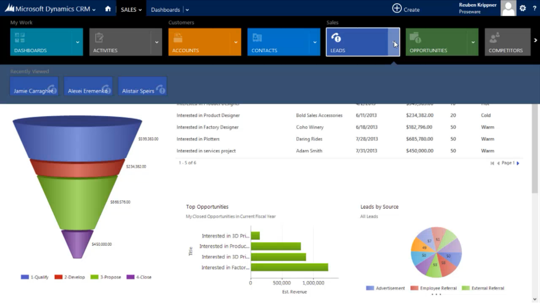
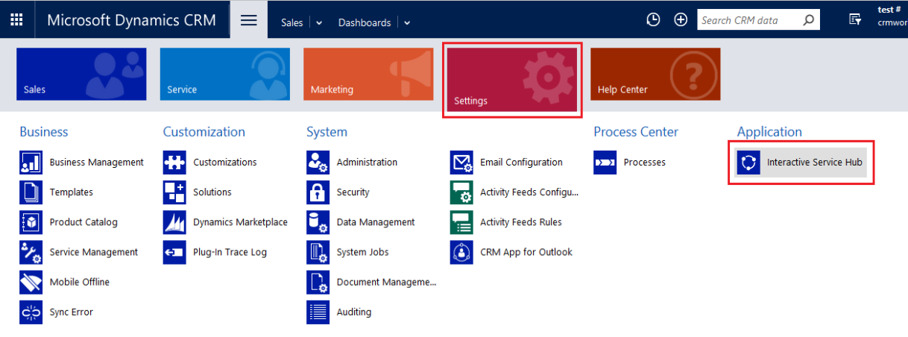
CRM
CRM Versions
CRM 2013
CRM 2016
EFFIGENT SOFTWARE SOLUTIONS
WWW.EFFIGENTSOLUTIONS.COM

Slide 7
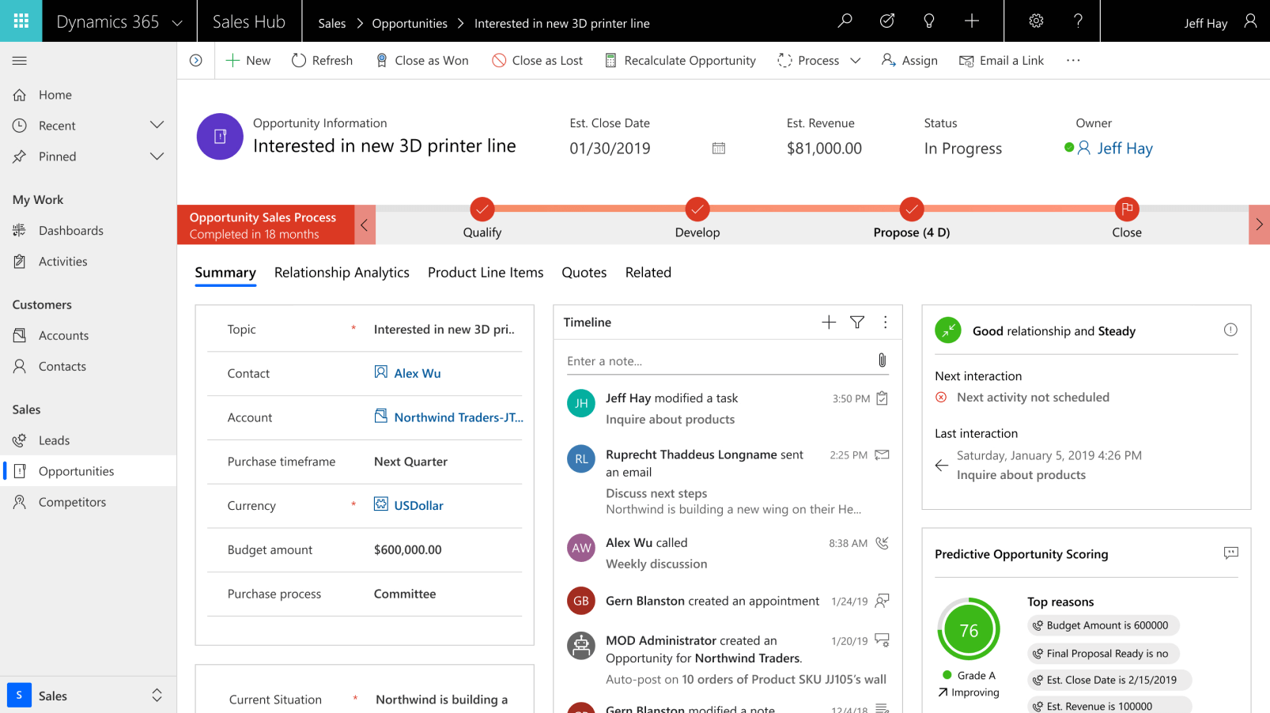
CRM
CRM Version
D365
EFFIGENT SOFTWARE SOLUTIONS
WWW.EFFIGENTSOLUTIONS.COM

Slide 8
CRM
Modules
Marketing
Sales
Services
Field Services
Project Service Automations
EFFIGENT SOFTWARE SOLUTIONS
WWW.EFFIGENTSOLUTIONS.COM

Slide 9
CRM
Security
Security Levels
None
User
Business Unit
Parent Business Unit
Organization
Security Privileges
Create
Update
Read
Delete
Append
Append to
Share
Assign
EFFIGENT SOFTWARE SOLUTIONS
WWW.EFFIGENTSOLUTIONS.COM

Slide 10
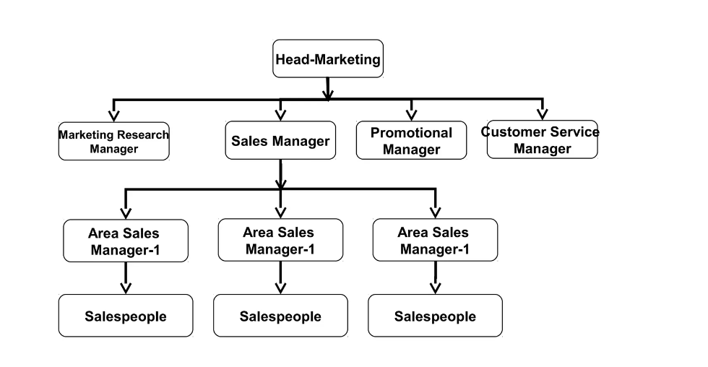
CRM
EFFIGENT SOFTWARE SOLUTIONS
WWW.EFFIGENTSOLUTIONS.COM

Slide 11
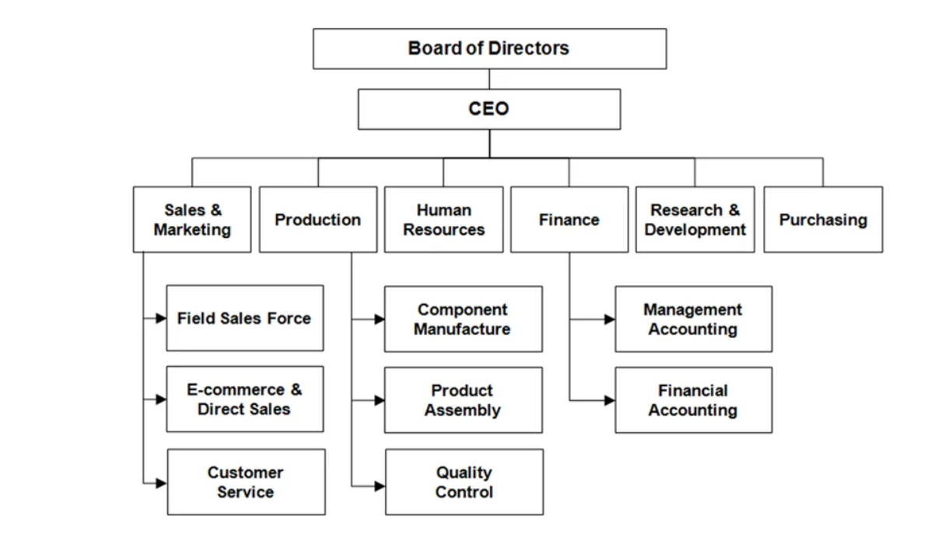
CRM
EFFIGENT SOFTWARE SOLUTIONS
WWW.EFFIGENTSOLUTIONS.COM

Slide 12
Dev
Testing
UAT
Prod

